Slide 1

CSE3BDC/CSE5BDC
Big Data Management on the Cloud
Lecturer: Zhen He
Lecture 6

Slide 2
Lecture Outline
Hadoop New Generation
  Motivation behind Spark
  How Spark works
  Programming Scala

Slide 3
Hadoop Ecosystem
What else is there in the open source Hadoop Ecosystem?
The tools in red font are the ones which we will cover in more detail.
Higher level programming abstractions
on top of MapReduce
  Pig
  Hive
  Mahout
Data Importing into HDFS
  Avro
  Sqoop
  Flume
Other tools
  Oozie
  ZooKeeper
NoSQL on Hadoop
  Hbase
Next Generation
  Interactive querying (based on Dremel)
    Impala
    Presto
    Search
  Yarn
    Storm
    Giraph
      Based on Pregal
  Berkley AmpLab
    Spark
    SparkSQL
    Spark streaming
    GraphFrames

Slide 4
Spark

Slide 5
Spark Motviation
MapReduce greatly simplified big data analysis
But as soon as it got popular, users wanted more:
  More complex, multi-stage applications (e.g.
  iterative graph algorithms and machine learning)
  More interactive ad-hoc queries
Both multi-stage and interactive apps require faster data sharing across parallel jobs

Slide 6
Spark Motivation
As we saw in the PageRank example, MapReduce performs very poorly when the program contains multiple iterations
  This is because the data needed to be stored on disk at the end of reduce and loaded again at the beginning of the next map.
  There are also structures like the graph structure which never changes but we still had to read it at the beginning of every map.
Pregel solved this problem for graph problems
But what about other types of iterative problems which are not graph related?
  For example most machine learning algorithms are iterative.

Slide 7
Spark is a General Framework
General framework that is low enough level that it can be used to replace all other frameworks.
  MapReduce, Pregel, Storm, Hive, Pig, etc.
It’s main advantage is that it allows iterative programs to take advantage of data caching.
  The data at the end of one iteration will be kept in RAM and passed directly to the next iteration without going to disk.
  Performance improvement over MapReduce most noticeable for iterative programs.
Does a bunch of other cool things
  Nice way of making fault tolerance really cheap
  Minimizes communication with some cool tricks

Slide 8
Throw out the rest
Spark can do everything the rest can do but do it better!
  Spark has a MapReduce API which allows you to directly run MapReduce at up to 100 times performance improvement
  Includes a graph API called GraphX which implements the Pregel API in 20 lines of code.
  SparkSQL includes the Hive API and is up to 100 times faster than Hive on MapReduce
  There is a streaming API on top of Spark that is 2 to 5 times faster than Storm.
  It has a nicer high level API than Pig and is faster than Pig
Spark is very popular and will likely replace most Hadoop MapReduce deployments in the near future.

Slide 9
Spark’s Approach
Instead of specializing, generalize MapReduce
to support new apps in same engine
Two changes (general task DAG & data caching) are enough to express all previous models!

Slide 10

Spark
Unifies batch, streaming, interactive comp.
Easy to build sophisticated applications
  Support iterative, graph-parallel algorithms
  Powerful APIs in Scala, Python, Java
Batch, Interactive
Data-parallel,
Iterative
Streaming
Sophisticated algos.
Spark
Streaming
SparkSQL
GraphX
MLlib
Spark
Batch, Interactive

Slide 11
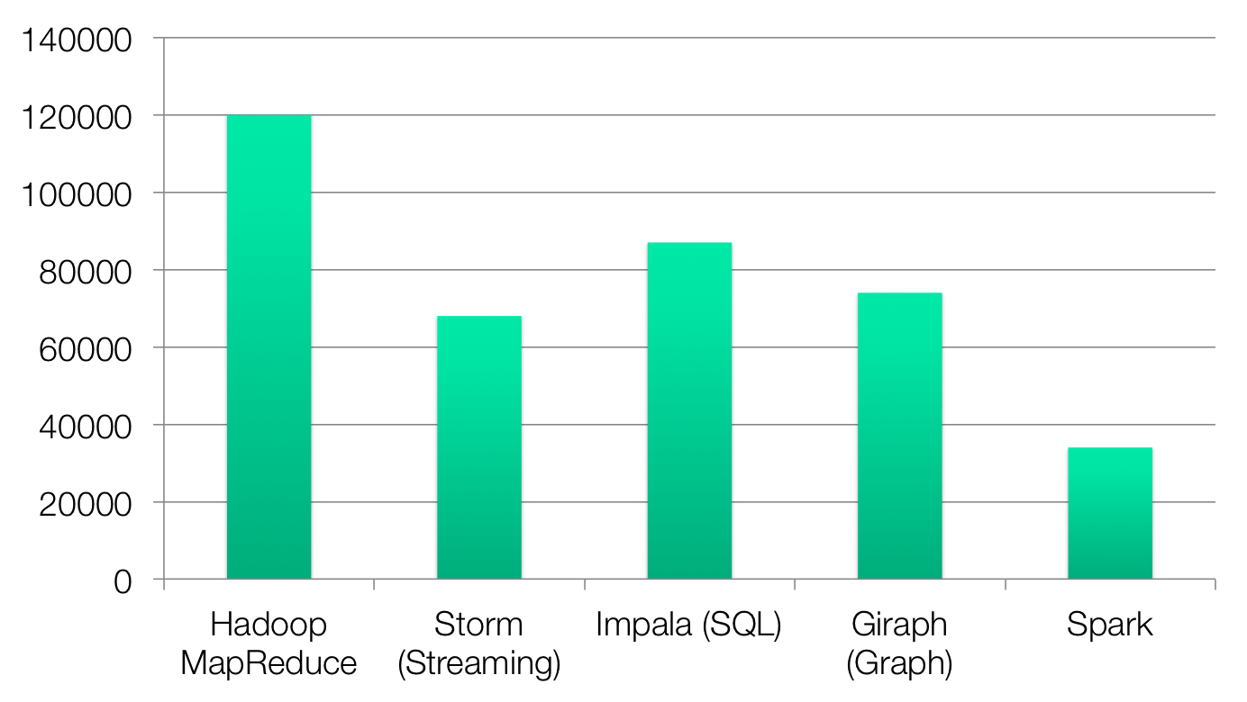
Code Size
non-test, non-example source lines

Slide 12
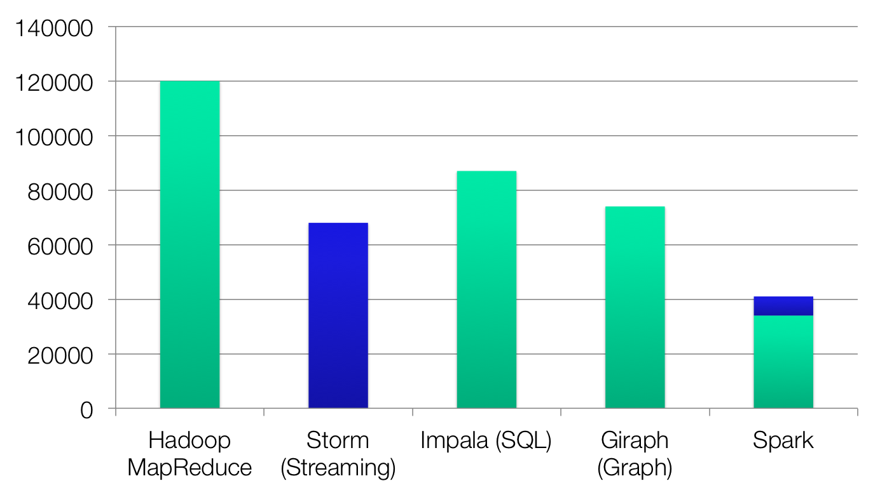
Code Size
Streaming
non-test, non-example source lines

Slide 13
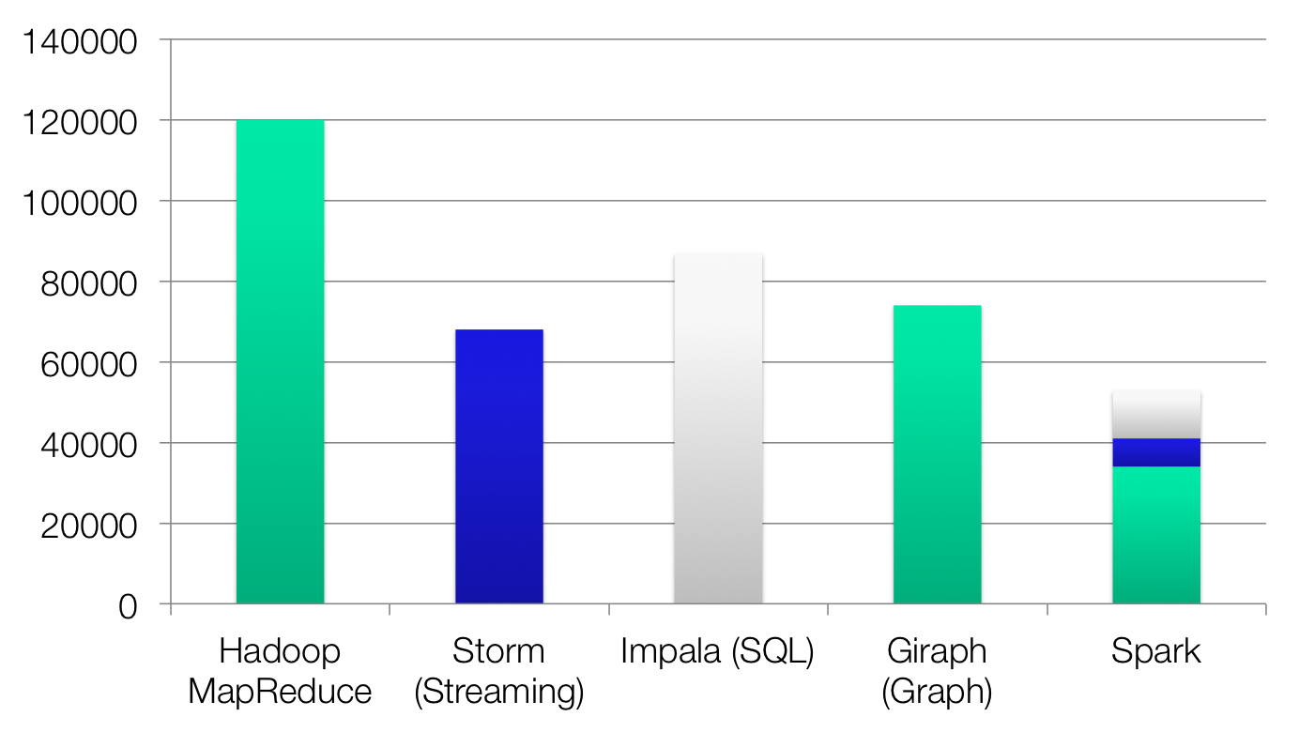
Code Size
SharkSQL
Streaming
non-test, non-example source lines

Slide 14
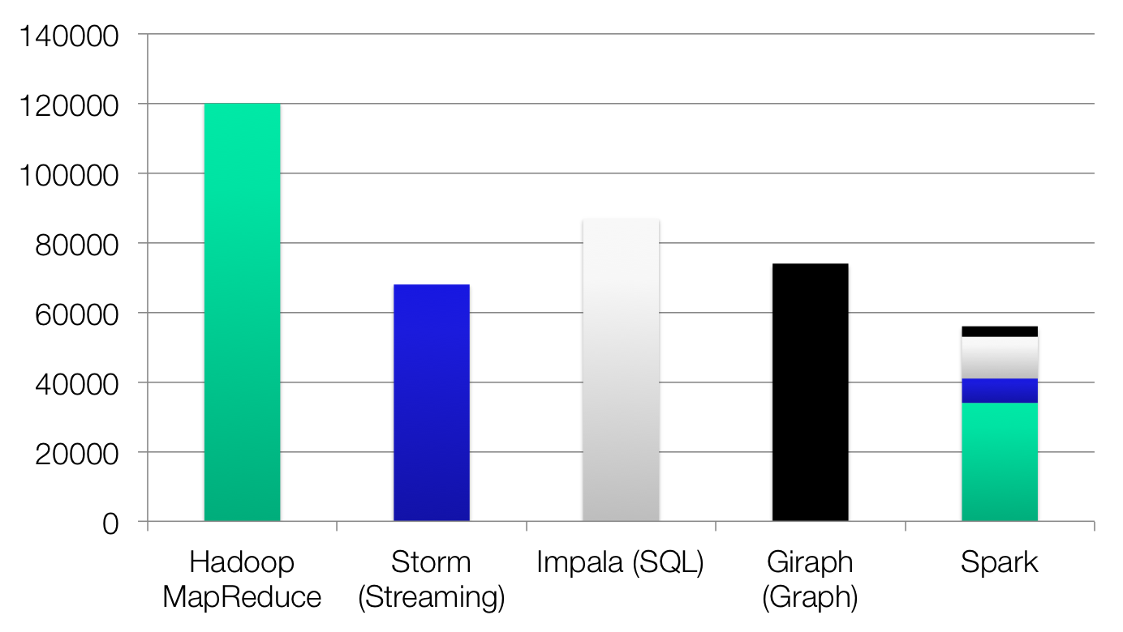
Code Size
GraphX
SparkSQL
Streaming
non-test, non-example source lines

Slide 15



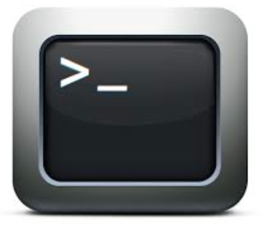





What it Means for Users
Separate frameworks:
HDFS read
HDFS write
HDFS read
HDFS write
HDFS read
HDFS write
…
Spark:
Interactive
analysis
HDFS read
HDFS

Slide 16
Combining Processing Types
From Scala:
val points = sc.runSql[Double, Double](
“select latitude, longitude from historic_tweets”)
val model = KMeans.train(points, 10)
sc.twitterStream(...)
.map(t => (model.closestCenter(t.location), 1))
.reduceByWindow(“5s”, _ + _)
The above example first runs a SQL query to project just two columns from a file containing historical twitter tweets
It then applies the machine learning algorithm KMeans clustering to find 10 cluster centers
Finally it treats the historical tweets as a data stream and then maps each point to the closest cluster center for windows of 5 second duration.

Slide 17

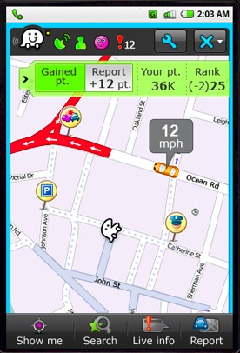





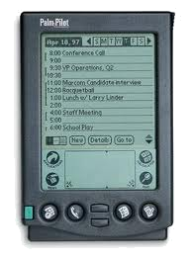



An Analogy
Better Phone
Better Games
z
Better GPS
First cellular
phones
Specialized
devices
Unified device
(smartphone)
Notes:
To illustrate the case for unification, consider the following analogy: the evolution of mobile devices.
First mobile phones enabled something new (phone calls anywhere), but were far behind the potential of the technology.
The next stage saw an explosion of specialized mobile devices: mobile phones, PDAs, GPS devices, MP3 players, handheld video games, video cameras.
The last stage has seen the apparition of iPhone, the first smartphone, which unifies the functionalities of all these devices. And what is great about an smartphone is not that it is a better camera than a proper camera or a better GPS than a proper GPs, but that it enables new applications, better than any of these devices can provide in isolation. Leverage crowd sourcing map applications, like waze, mubile multi-player games, appliactions like instagram where users can immediately share their pictures, and many more!

Slide 18






An Analogy
Batch processing
Specialized
systems
Unified
system
Notes:
A similar evolution is taking place in the big data space.
Hadoop provided a new capability, …
Soon people needed more than batch processing, and they started building a plethora of specialized frameworks, storm for streaming, graphlab for graph computation, and so on.
We believe the logical next step in the evolution is Spark that unifies the functionalities of many of the previously he same way the smartphone has unified the functionality of many mobile devices. And like smarthpone, we believe that this unification will enable developers to write new applications which are fundamentally better than what they can do today.

Slide 19
Turning Data into Value, Examples
Unify real-time and historical data analysis
  Easier to build and maintain
  Cheaper to operate
  Easier to get insights, faster decisions
Unify streaming and machine-learning
  Faster diagnosis, decisions (e.g., better ad targeting)
Unify graph processing and Extract Transform and Load (ETL)
  Faster to get social network insights (e.g., improve user experience)
Notes:
Next, let me give three examples showing how unification can enable new applications or improve existing ones.

Slide 20
Graph Processing and ETL
Imagine you are trying to do some graph analytics on Wikipedia data.
You need to a lot of ETL in order to get the data in the right format to be put into a graph engine
  ETL: extract transform and load
In traditional Hadoop you need to create workflows like
  Use MapReduce to do ETL
  Run graph engine on the output of the MapReduce
In spark you can do everything together in the same script within minutes.

Slide 21







Spark Users

Slide 22














Popularity of Apache Spark
More than 3000 companies using Apache Spark
Spark had more than 1000 contributors in 2015
  one of the most active projects in the Apache Software Foundation
Notes:
Alibab, tenzent
At Berkeley, we have been working on a solution since 2009. This solution consists of a software stack for data analytics, called the Berkeley Data Analytics Stack. The centerpiece of this stack is Spark.
Spark has seen significant adoption with hundreds of companies using it, out of which around sixteen companies have contributed back the code. In addition, Spark has been deployed on clusters that exceed 1,000 nodes.

Slide 23
Project History
Spark built by the students of the Berkely AMP Lab
Spark project started in 2009, open sourced 2010
Shark started summer 2011, alpha April 2012
In use at Berkeley, Princeton, Klout, Foursquare, Conviva, Quantifind, Yahoo! Research & others
In 2013, the project was donated to the Apache Software Foundation and switched its license to Apache 2.0.
In February 2014, Spark became a Top-Level Apache Project
In June 2015
  IBM announced it would put 3500 IBM researchers and developers to work on Spark-related projects
  IBM will educate more than 1 million data scientists and data engineers on Spark

Slide 24
References for More Detail
Due to time constraints I can only only give a relatively brief description of spark.
To write high performing spark code you should know more
Watch these videos
  Spark Programming
    http://www.youtube.com/watch?v=7k4yDKBYOcw
    http://www.youtube.com/watch?v=w0Tisli7zn4
  Shark
    http://www.youtube.com/watch?v=qSQDpSSafmg
  Spark streaming
    http://www.youtube.com/watch?v=g171ndOHgJ0
  Understanding performance bottlenecks in spark
    http://www.youtube.com/watch?v=NXp3oJHNM7E
  Scala
    http://www.youtube.com/watch?v=_qRYOayG9SM

Slide 25
Lecture Outline
Hadoop Next Generation
  Motivation behind Spark
  How Spark works
  Programming Scala

Slide 26
What is Spark?
Not a modified version of Hadoop
Separate, fast, MapReduce-like engine
  In-memory data storage for very fast iterative queries
  General execution graphs and powerful optimizations
  Up to 40x faster than Hadoop
Spark was published in the following conference.
  Matei Zeharia, Mosharaf Chowdhury, Tathagata Das, et al., Resilient Distributed Datasets: A Fault-Tolerant Abstraction for In-Memory Cluster Computing, NSDI 2012.
    NSDI is the top conference for networking systems. This paper won the best paper award for 2012.

Slide 27
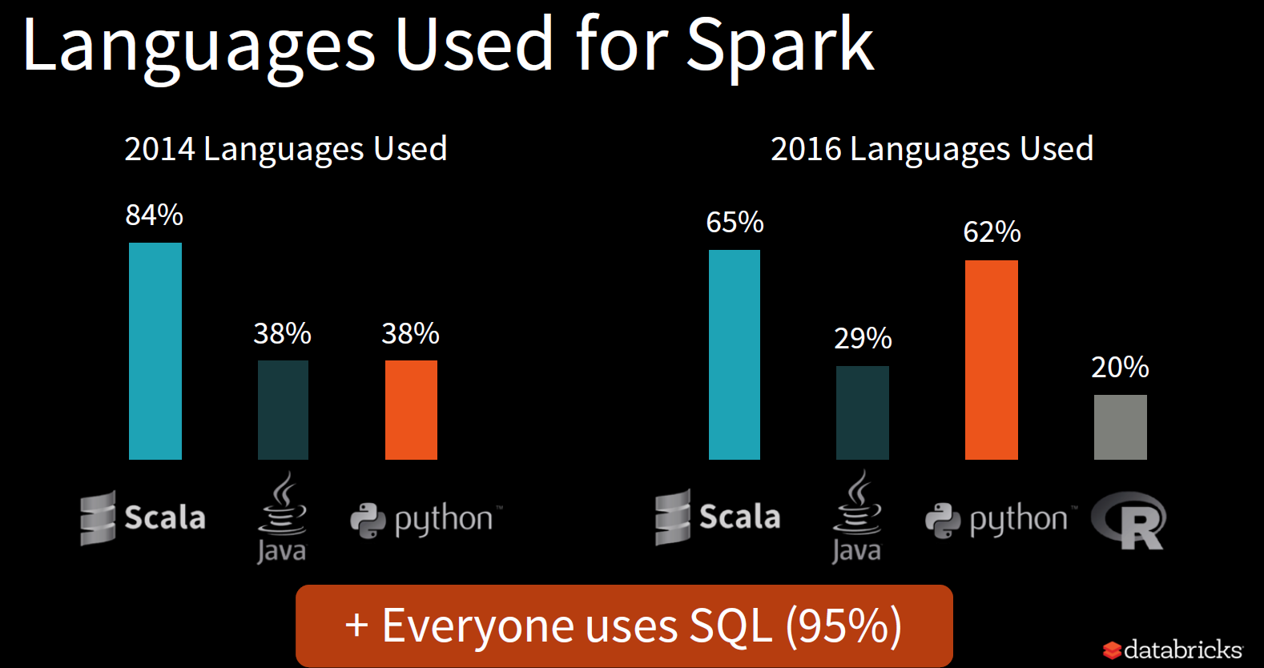


Slide 28
Hadoop Compatibility
Spark can read/write to any storage system / format that has a plugin for Hadoop!
  Examples: HDFS, S3, HBase, Cassandra, Avro, SequenceFile
  Reuses Hadoop’s InputFormat and OutputFormat APIs
APIs like SparkContext.textFile support filesystems, while SparkContext.hadoopRDD allows passing any Hadoop JobConf to configure an input source

Slide 29
Spark Software Stack
Shark
(Hive on Spark)
GraphX
Streaming Spark
…
Spark
Local mode
EC2
Apache Mesos
YARN

Slide 30
Awesome Usability
Supports the following APIs
  Scala
  Java
  Python
Interactive shell
Scala is a really nice way to write programs!
I totally recommend that you program Spark using Scala
Before talking about the awesome Scala API we will first talk about what makes Spark so fast.

Slide 31
Data Sharing in MapReduce
HDFS
read
HDFS
write
HDFS
read
HDFS
write
iter. 1
iter. 2
. . .
Input
HDFS
read
query 1
result 1
query 2
result 2
query 3
result 3
Input
. . .
Scenario 1(iterative algorithms): MapReduce needs to read and write to HDFS in between every iteration
Scenario 2(multiple queries): even for a set of queries working on the same data, the data need to be loaded from HDFS at the beginning of every job.

Slide 32

Data Sharing in Spark
iter. 1
iter. 2
. . .
Input
query 1
one-time
processing
query 2
query 3
Input
Distributed
memory
. . .
Scenario 1(iterative algorithms): Spark caches all the data in memory so no need to read and write to HDFS in between every iteration
Scenario 2(multiple queries): Spark can cache data that is used by different queries in RAM thereby avoid reading from HDFS for every query.

Slide 33
Spark Programming Model
Key idea: resilient distributed datasets (RDDs)
  Distributed collections of objects that can be cached in memory across cluster nodes
  Manipulated through various parallel operators
  Automatically rebuilt on failure

Slide 34

Example: Log Mining
Load error messages from a log into memory, then interactively search for various patterns
  In the example below lines, errors, messages, cachedMsgs are all RDDs
  Don’t worry if you do not understand all the details we will cover scala in much more detail later.
Base RDD
Cache 1
lines = spark.textFile(“hdfs://...”)
errors = lines.filter(_.startsWith(“ERROR”))
messages = errors.map(_.split(‘\t’)(2))
cachedMsgs = messages.cache()
Worker
Transformed RDD
results
tasks
Block 1
Driver
Action
cachedMsgs.filter(_.contains(“foo”)).count
cachedMsgs.filter(_.contains(“bar”)).count
Cache 2
Worker
. . .
Result: scaled to 1 TB data in 5-7 sec
(vs 170 sec for on-disk data)
Cache 3
Result: full-text search of Wikipedia in <1 sec (vs 20 sec for on-disk data)
Worker
Block 2
Block 3

Slide 35
Properties of RDDs
lines = spark.textFile(“hdfs://...”)
errors = lines.filter(_.startsWith(“ERROR”))
messages = errors.map(_.split(‘\t’)(2))
cachedMsgs = messages.cache()
cachedMsgs.filter(_.contains(“foo”)).count
cachedMsgs.filter(_.contains(“bar”)).count
Each line of code transforms the data from one RDD to another.
All RDDs are read only.
  This property is very important. It means multiple tasks can share the data without worrying about race conditions.
    No chance of inconsistent state from multiple concurrent writes.
All of the above RDDs are temporary collections meaning they will be automatically destroyed when no longer in use except for cachedMsgs
The cachedMsgs RDD is cached in RAM and therefore subsequent methods on the RDD will be run in RAM.

Slide 36
Partitions
RDD
RDDs are stored distributed across the cluster
Each node of the cluster stores a separate partition of the RDD.
Spark like MapReduce always tries to move the computation to the data.
When operating on the data stored in HDFS it consults HDFS to find where the data is stored before launching its work tasks on it.

Slide 37
Partitions
RDD
Users can ask that an RDD’s elements be partitioned across machines based on a key in each record.
  This is useful for placement optimizations
    E.g. if two datasets are hash-partitioned the same way then it is much cheaper to join them using the knowledge of the partition information.

Slide 38
Action
lines = spark.textFile(“hdfs://...”)
errors = lines.filter(_.startsWith(“ERROR”))
messages = errors.map(_.split(‘\t’)(2))
cachedMsgs = messages.cache()
cachedMsgs.filter(_.contains(“foo”)).count
cachedMsgs.filter(_.contains(“bar”)).count
Like pig the spark interpreter does not actually execute any commands until an action is encountered.
  This is called lazy evaluation
  It gives the system a chance to inspect all the code before working out the best execution plan
Actions are operations that return a value to the application or export data to a storage system
Example actions
  Count: returns the number of elements in the dataset
  Collect: returns the elements themselves
  Save: outputs the dataset to a storage system

Slide 39
Storage options for persistent RDDs
RDD can be made persistent in the following three ways
Deserialized and in memory
  This is the fastest method since it means the objects can be reused without the overhead of serialization/deserialization
    The computational cost of serialization/deserialization can be very high in Java.
  This is the same as using the .cache() method call
  Example
    pMsg = messages.persist(spark.storage.StorageLevel.MEMORY_ONLY)
      Same as:
    pMsg = messages.cache();
Serialized and in memory
  This can significantly reduce the memory footprint of the cached objects.
  For example a linked list of integers contains the following per item
    4 byte data, 8 byte pointer, etc.
    We only need to store the 4 byte data per item if the data is serialized
  Example
    pMsg = Messages.persist(spark.storage.StorageLevel.MEMORY_ONLY_SER)

Slide 40
Storage options for persistent RDDs
Persistent RDDs can be stored on disk
  Good when too large to fit in memory but too costly to recompute.
  Example
    pMsg = messages.persist(spark.storage.StorageLevel.DISK_ONLY)
Sometimes RDDs do not all fit in memory
  Use Least Recently Used policy to evict entire RDDs

Slide 41
Fault Tolerance
RDDs track the series of transformations used to build them (their lineage) to recompute lost data
E.g:
messages = textFile(...).filter(_.contains(“error”))
.map(_.split(‘\t’)(2))
HadoopRDD
path = hdfs://…
FilteredRDD
func = _.contains(...)
MappedRDD
func = _.split(…)

Slide 42
Fault Tolerance
messages = textFile(...).filter(_.contains(“error”))
.map(_.split(‘\t’)(2))
HadoopRDD
path = hdfs://…
FilteredRDD
func = _.contains(...)
MappedRDD
func = _.split(…)
RDDs provide an interface for coarse-grained transformations which makes fault tolerance much cheaper via lineage
  Contrast this to traditional methods of
    Storing a log record of every update to every single record.
      High storage and latency cost.
    Replication of data
      Waste of disk and memory
If a partition of a RDD is lost, the RDD has enough information about how it was derived to recompute just that partition

Slide 43
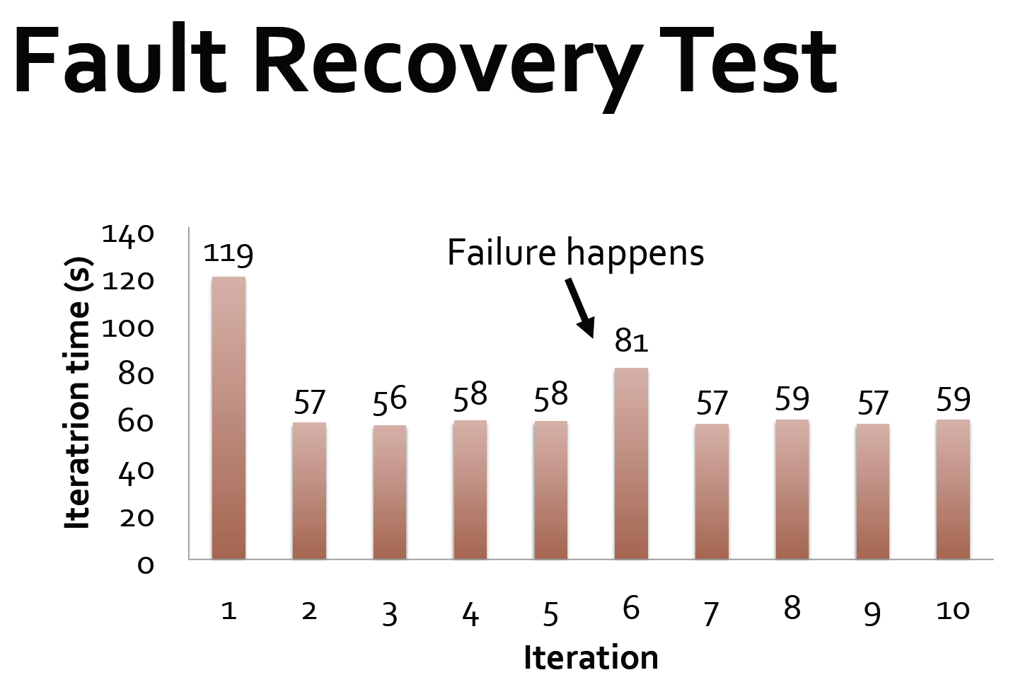

Slide 44
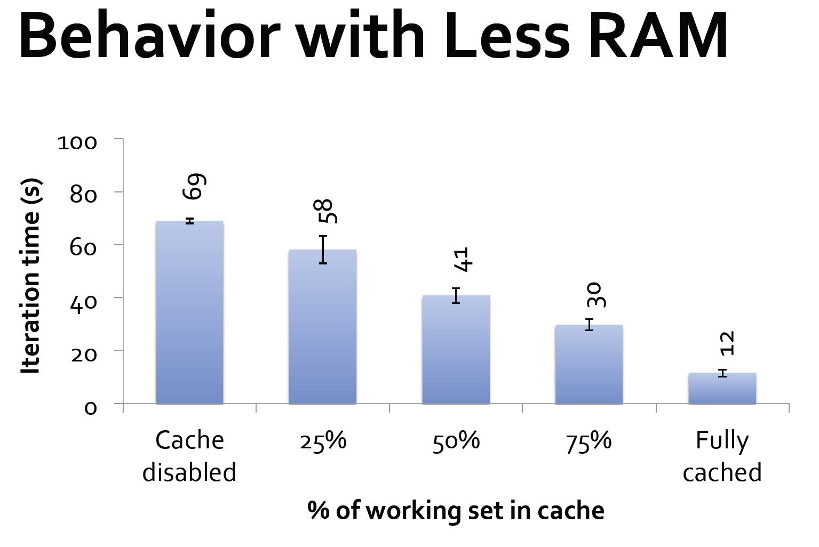

Slide 45
Lecture Outline
Hadoop Next Generation
  Motivation behind Spark
  How Spark works
  Programming Scala

Slide 46
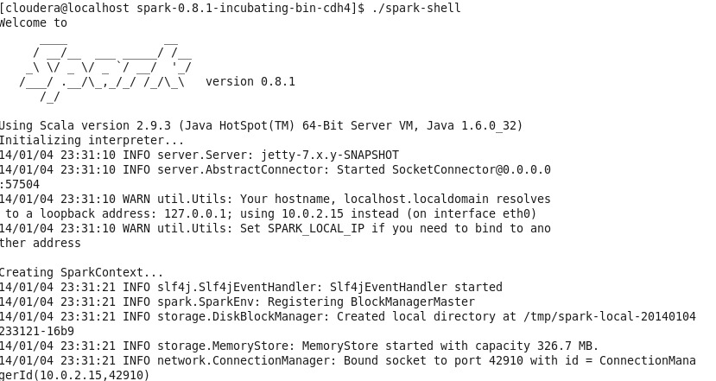
Scala
Before going to more detail on how to program Spark we will first give a small course on how to program Scala
The scala or spark interpreter is the best way to learn Scala
  ./spark-shell

Slide 47
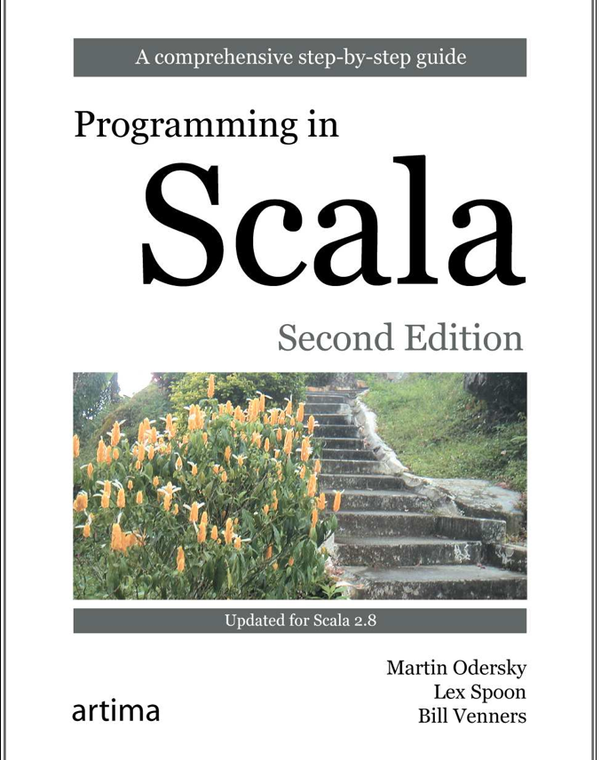
Book
Very nice book on Scala.
I totally recommend buying this book if you want to learn more about Scala.

Slide 48
Scala
Scala stands for “scalable language”
  Designed to grow with the demands of its users
  Good for both small and large systems
Blend of object-oriented and functional programming concepts.
  Functional: allows you to build interesting things quickly
  Object-oriented: easier to structure larger systems and to adapt them to new demands.
Runs on the standard Java platform
  Interoperates seamlessly with all Java libraries
    Java objects can be easily used within Scala

Slide 49
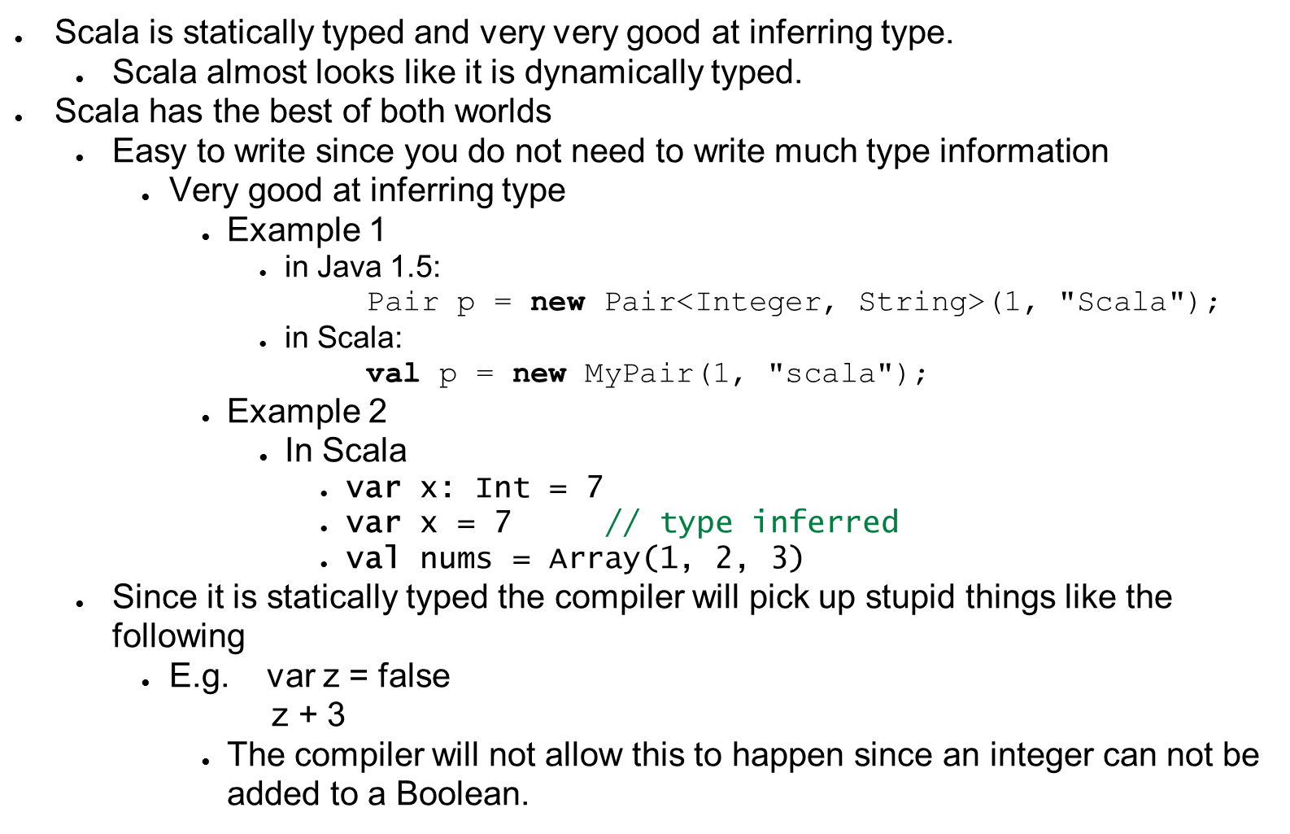
Statically Typed

Slide 50
Basics
scala> 1 + 2
res0: Int = 3
Semicolons at the end of statements are optional!
scala> res0 + 4
res1: Int = 7
The result of an expression is stored in a variable called res0, res1, res2 etc.
  The result variable can then be used by another expression.
scala> println(“Hello, world!”)
Hello, world!

Slide 51
Variables
var x = 7 // can be modified
X = 20 // ok allowed
val y = “hi” // read-only
y = “there” // error can not modify a read only variable
Variables declared using var can be modified
Variables declared with val are read-only

Slide 52
Scripts
You can write scripts like the following which takes a command line argument
println(“Hello, “ + args(0) + “!”)
Then run the following at the command line to run the script (assuming the script is stored in the file called helloarg.scala)
$ scala helloarg.scala planet
  The output would be:
    Hello planet

Slide 53
Arrays
val greetStrings = new Array[String](3)
greetStrings(0) = “Hello”
greetStrings(1) = “, “
greetStrings(2) = “world!\n”
for (i <- 0 to 2)
print(greetStrings(i))
Note arrays are indexed using () instead of the usual []
Arrays in Scala are mutable meaning you can modify the contents of the array without needing to create a new Array.

Slide 54
Lists
Lists are preferred in comparison to arrays in Scala
  Functional programming: methods should not have side effects (functions should not mutate collections passed into it)
    This makes methods more reliable
  In contrast, Scala array is a mutable sequence of objects
val oneTwo = List(1, 2)
val threeFour = List(3, 4)
val oneTwoThreeFour = oneTwo ::: threeFour
println(oneTwo + “ and “ + threeFour + “were not mutated.”)
println(“Thus, “ + oneTwoThreeFour + “ is a new list.”)
The output is
List(1, 2) and List(3, 4) were not mutated
Thus, List(1, 2, 3, 4) is a new list.
The ::: is used to concatenate two lists.

Slide 55
Lists
Lists are by default immutable. So when you add something to a list Scala will create a new list.
You can mutate lists inplace by using a list from the mutable collection.

Slide 56
Add to front of list instead of append to the end
The following discussion relates to the default immutable lists.
Adding to the front of a list is a constant cost operation since just involves creating a new list with a head and then attaching the old list behind it.
However, appending to the end of the list costs linear time since it involves copying the entire list to the new list and then adding the last one to the end.
val twoThree = List(2, 3)
val oneTwoThree = 1 :: twoThree
println(oneTwoThree)
Output
List(1, 2, 3)
The above shows how to add an item at the beginning of a list
val twoThree = List(2, 3)
val twoThreeOne = twoThree :+ 1
Println(twoThreeOne)
Output
List(2, 3, 1)
The above shows how to append an item at the end of a list. Slow.

Slide 57
Use Tuples
Effectively just objects with no field names
  Just data!
val pair = (99, “Luftballons”)
println(pair._1)
println(pair._2)
The following is outputted
99
Luftballons
The ._1 and ._2 are used to refer to the first and second members of the pair respectively.
Tuples can have an arbitrary number of elements, not just 2 as in the example above.

Slide 58
Maps
val romanNumeral = Map(1 -> “I”, 2 -> “II”, 3 -> “III”)
println(romanNumeral(1))
Output:
I
The above shows how to use an immutable map.
By default maps in Scala are immutable.
However, the above immutable map can not have any items added.
val treasureMap = scala.collection.mutable.Map[Int, String]()
treasureMap(2) = “Find big X on the ground.”
println(treasureMap)
Output:
Map(2 -> Find big X on the ground.)
The above shows how to use a mutable map
Mutable maps allow you to insert elements

Slide 59
Sets
val jetSet = Set(“Boeing”, “Airbus”)
println(jetSet.contains(“Cessna”))
Output:
false
The above shows an example using a set.
  By default sets are immutable and so you can not add any elements
val jetSet = scala.collection.mutable.Set("Boeing", "Airbus")
jetSet += "Lear”
println(jetSet)
Output:
Set(Airbus, Boeing, Lear)
The above shows an example inserting into a mutable set.

Slide 60
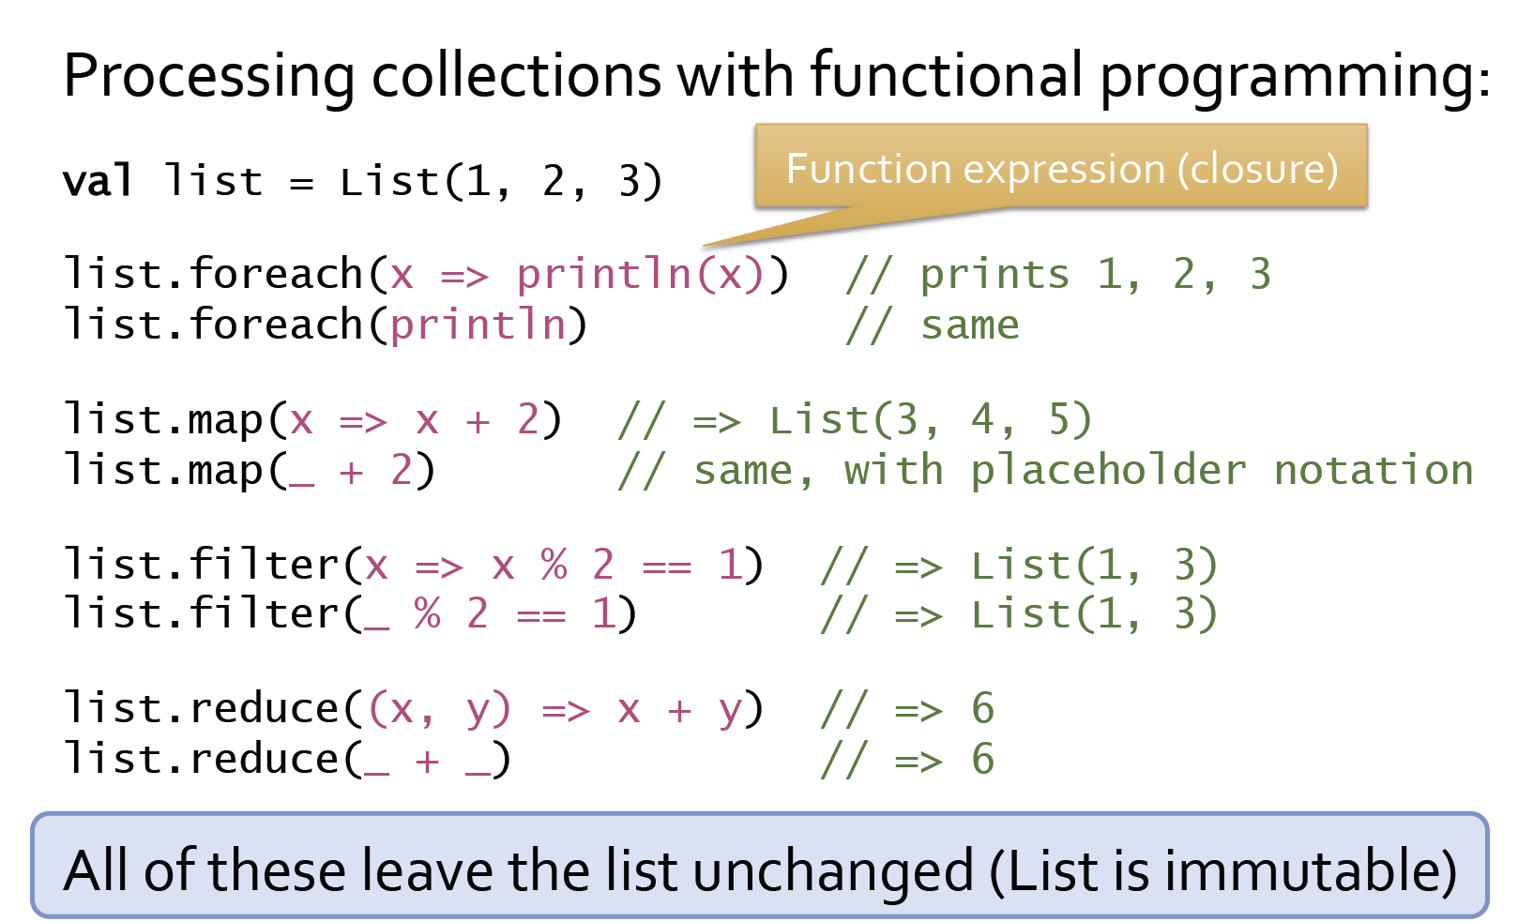
Collections with Functional Programming

Slide 61
How the map function works
List (x = 1, x = 2, x = 3)
Map function
x => x + 2
3 4 5
Transforms each of the input values using the map function

Slide 62
How the Filter Function Works
List (x = 1, x = 2, x = 3)
Filter function
x => x % 2 == 1
true
false
true
1 3
Keeps all the values in the input list evaluates to true on the filter function.

Slide 63
How the Reduce Function Works
List (x = 1, y = 2, y = 3)
Reduce function
(x, y) => x + y
x = 3
(x, y) => x + y
6
Applies the reduce function on every pair of input values.

Slide 64
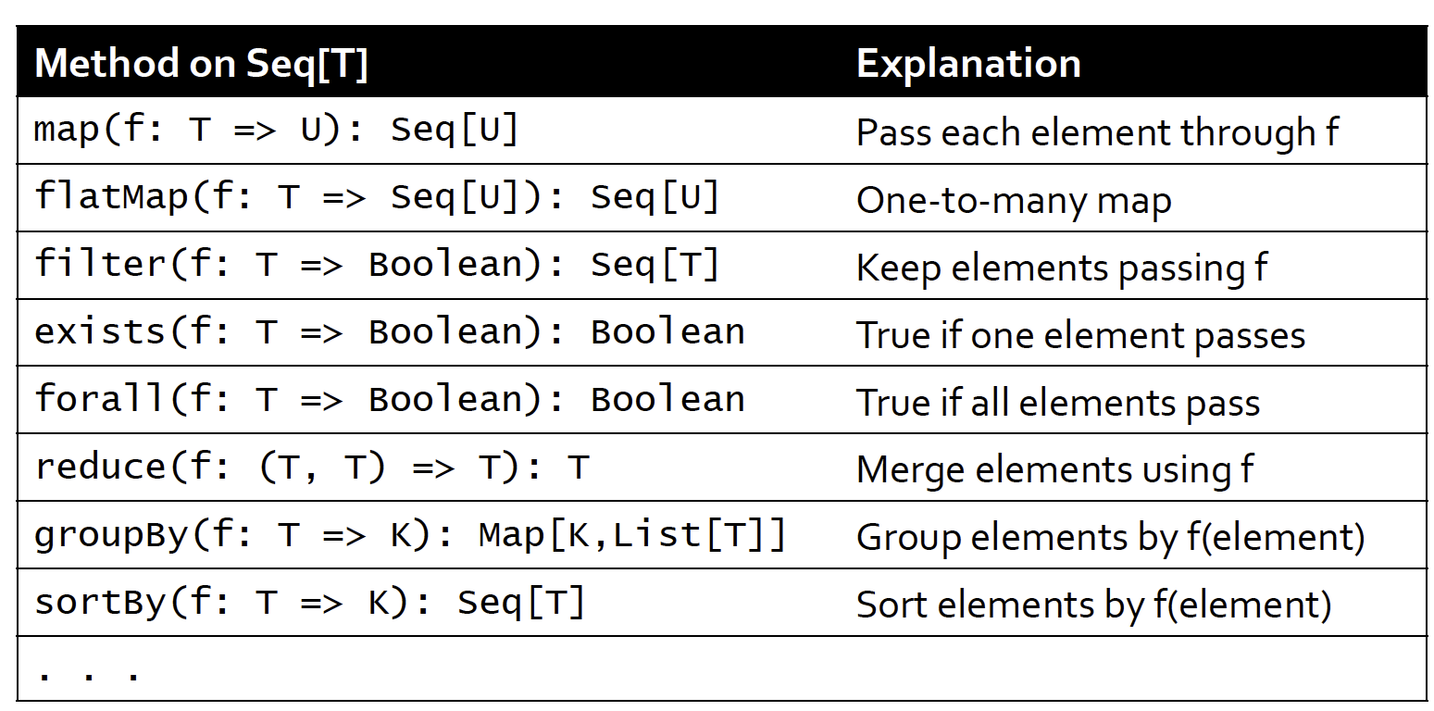
Other Collection Methods
Here are some of the more useful collection methods defined for the sequence class Seq[T].
The Seq[T] class is the base class that all sequential collections are inherited from, include the following: Array, Range, List, Vector, etc.
Therefore all these operations are available for collections such as Array, Range, List, Vector, etc.

Slide 65
Scala is Object Oriented
Pure object oriented language
  Every value is an object
  Every operation is a method call
    E.g. 1 + 2
      Actually invoking a method named + in class Int.
Offers Traits and other object oriented features through features like mixin classes, etc.
  If you want to learn more please read a book on Scala.

Slide 66
Defining Classes
Java class
class MyClass {
private int index;
private String name;
public MyClass(int index, String name) {
this.index = index;
this.name = name;
}
}
Scala Class
class MyClass(index: Int, name: String)
Which one would you prefer to write?
Given the above code the Scala compiler will produce a class that has
  Two private instance variables
    Int named index
    String named name
  A constructor that will initialize the two instance variables with the values passed as parameters.

Slide 67
Functions and Methods

Slide 68
Functions Should Not Have Any Side Effects!
Always aim to write a function such that it does not change the state of anything else!
For example passing by reference and modifying the passed in object is bad.
void modify(SomeObject s) {
s->setXValue(2);
}
Functions that do not change state are much safer to use in parallel situations.
  The same function can be passed to many different workers without worrying about concurrency issues.
None of the following function examples change state.
  They return things
  They do things (like print something)

Slide 69
Function Declaration
scala> def max(x: Int, y: Int) : Int = {
  if (x > y) x
  else y
  }
max: (x: Int, y: Int) Int
Function definitions start with def
A type annotation must follow every function parameter
The : Int = at the end of the function prototype specifics the function returns an integer.
If a function body is just one line you can leave out the { } like the following
scala> def max2(x: Int, y: Int) = if (x > y) x else y
max2: (x: Int, y: Int) Int
Below is a function that takes no parameters and returns nothing
scala> def greet() = println(“Hello, World!”)
greet: () Unit
  The Unit means the function returns nothing.

Slide 70
Functions that Return Things
def square(x: Int) : Int = { x* x}
The last expression in the block is returned
You can write a return if you want to
def square(x: Int) : Int = { return x* x }
This is the same as the Java function below
int square(int x) {
return x*x;
}

Slide 71
How to Define Methods
    import scala.io.Source
    object LongLines {
      def processFile(filename: String, width: Int) {
      val source = Source.fromFile(filename)
      for (line <- source.getLines())
      processLine(line)
      }
      def processLine(line: String) {
      if (line.length > width)
      println(filename + “: “ + line)
      }
    }
The above shows how to define a method inside a class.
It is quite similar to Java.

Slide 72
Function literals
(x: Int) => x + 1 or
(x) => x + 1 // infer type
Function literals are functions that have no name
The => designates that this function converts the thing on the left (any integer x) to the the thing on the right (x + 1)
  This is a function mapping any integer x to x+1
If you want more than one statement in the function literal, surround its body by curly braces and put one statement per line.
  For example
    (x: Int) => {
    println(“We”)
    println(“are”)
    println(“here!”)
    x + 1
    }

Slide 73
Function Literals
Here is a function literal used as an argument in a method that takes two arguments
    scala> val abc = List(1,2,3,4,5,6)
    abc: List[Int] = List(1, 2, 3, 4, 5, 6)
    scala> abc.reduce((x, y) => x + y)
    res2: Int = 21
In the above example the reduce method is applied on the list to sum up all the numbers into the list into one number.
Therefore the output of the above function literal is just one integer.

Slide 74
Place Holder Syntax
scala> val someNumbrs = List(-11, -10, -5, 0, 5, 10)
someNumbers: List(-11, -10, -5, 0, 5, 10)
scala> someNumbers.filter(_ > 0)
res1: List[Int] = List(5, 10)
Use the underscores as placeholders for one or more parameters

Slide 75
What you can do with Scala Functions
Functions are first class values
  A function is a value of the same status as say, an integer or string
    You can pass functions as arguments to other functions.
      For example
        scala> val someNumbers = List(-11, -10, -5)
        someNumbers: List[Int] = List(-11, -10, -5)
        scala> someNumbers.foreach((x: Int) => println(x))
        -11
        -10
        -5
      The foreach method of the list someNumbers takes functions as an argument.
    Store functions as variable objects
      For example
        scala> var increase = (x: Int) => x + 1
        increase: (Int) => Int = <function1>
        scala> increase(10)
        res0: Int = 11

Slide 76
Closure
So far all the function examples have only referred to passed parameters
  Therefore these functions do not depend on the state of free variables.
However, the following literal function declaration does depend on the state of a free variable called more.
var more = 1
val addMore = (x: Int) => x + more
In contrast, the variable x is a bound variable.
  Function parameter
The function value (the object) that’s created at runtime from this function literal is called a closure.
  The name arises from the act of “closing” the function literal by “capturing” the bindings of its free variables.
Closure has important implications for Spark since in Spark any free variables used in functions need to be broadcasted to all the tasks executing the function.

Slide 77
Pattern matching in Scala
A very powerful feature of Scala is its ability to do pattern matching using case.
Remember this in Java?
int month = 0;
String monthString;
  switch (month) {
  case 1: monthString = “January”;
  break;
  case 2: monthString = “Feburary”;
  break;
  ..
  default: monthString = “Invalid month”;
  break;
  }
In Java the switch statement can only be used to match constants of a certain type.
This is very limited.
Scala can do much more.

Slide 78
Pattern matching in Scala
def describe( x : Any) = x match {
case 5 => “five”
case true => “truth”
case “hello” => “hi!”
case Nil => “the empty list”
case _ => “something else”
}
Then you use the describe function like the following
scala> describe(5)
res6: java.lang.String = five
scala> describe(Nil)
res7: java.lang.String = the empty list
scala> describe(List(1,2,3))
res8: java.lang.String = something else
The above test the value in the parameter x to see if they match various constants
The _ is the default case which catches everything that has not matched before.

Slide 79
Difference between Scala match and Java Switch
Scala match is more general than Java Switch
  Java switch just does constants of a single type
Scala’s match is an expression therefore it always results in a value.
Scala’s alternative expressions never “fall through” into the next case.
If none of the patterns match, Scala throws an exception named MatchError
  You always have to make sure all cases are covered.
    Add a default case

Slide 80
More Examples of Pattern matching in Scala
expr match {
case 0 => “zero”
case somethingElse => “not zero: ” + somethingElse
}
somethingElse is like the wildcard _ except you can use this variable to act on the object further.
expr match {
case List(0, _, _) => println(“found it”)
case _ =>
}
Checks for a three-element list starting with zero.
expr match {
case List(0, _*) => println(“found it”)
case _ =>
}
Matches any list that starts with zero, regardless of how long the list is.

Slide 81
More Examples of Pattern matching in Scala
def tupleDemo(expr: Any) =
expr match {
case (a, b, c) => println(“matched “ + a + b + c)
case _ =>
}
scala> tupleDemo((“a”, 3, “-tuple”))
matched a 3-tuple
Matches arbitrary 3-tuples.
def generalSize(x : Any) = x match {
case s: String => s.length
case m: Map[_, _] => m.size
case _ => -1
}
scala> generalSize(“abc”)
res16: Int = 3
scala> generalSize(Map(1 -> ‘a’, 2 -> ‘b’))
res17: Int = 2
The above typed pattern can be used as a convenient replacement for type tests and type casts.

Slide 82
Conclusion
In this lecture we learnt:
  The motivation for using Spark
  An overview of how Spark works
  How to program in Scala

